Slide 1

Budget wise AI
Based expense
forecasting tool
🎯 MILESTONE 1: User Authentication & Basic Transaction Input

Slide 2
Milestone 1 Objectives
High-Level Requirements Achieved:
✅ User Registration System with JWT Security
✅ Robust Login Mechanism for User Authentication
✅ User Profile Management for Financial Data
✅ Manual Transaction Input Interface
✅ Secure Backend API with Flask
✅ Interactive Frontend with Streamlit

Slide 3
User Authentication System
Secure Registration: Email/password with bcrypt hashing
JWT Token Security: 7-day expiration with secure validation
Session Management: Automatic token handling
User Isolation: Each user sees only their own data
Error Handling: Comprehensive auth failure messages
Technical Implementation:
Backend: Flask with JWT tokens
Password: bcrypt hashing
Frontend: Streamlit session state management
Database: SQLite with user table

Slide 4

Transaction Management System
📅 Date Selection: Calendar picker for transaction dates
💰 Amount Input: Numeric input with validation
📝 Description Field: Text input for transaction details
🔸 Type Selection: Income/Expense toggle
🏷️ Category Dropdown: Predefined categories with AI auto-suggest
Data Validation:
Amount must be > 0
Date format validation
Required field checks
Server-side error handling

Slide 5
Technical Architecture - Milestone 1
Frontend (Streamlit)
↓
Backend API (Flask)
↓
Database (SQLite)
↓
User Table + Transactions Table

Slide 6
Frontend: Streamlit web interface
Backend: Flask REST API with CORS
Authentication: JWT tokens with bcrypt
Database: SQLite with proper schema
Security: Password hashing, token validation

Slide 7
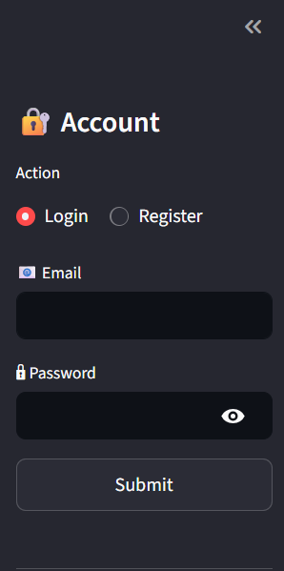
User Interface - Authentication

Slide 8
Features Shown:
Clean login/register toggle
Email and password fields
Success/error message display
Quick insights sidebar
Responsive design

Slide 9
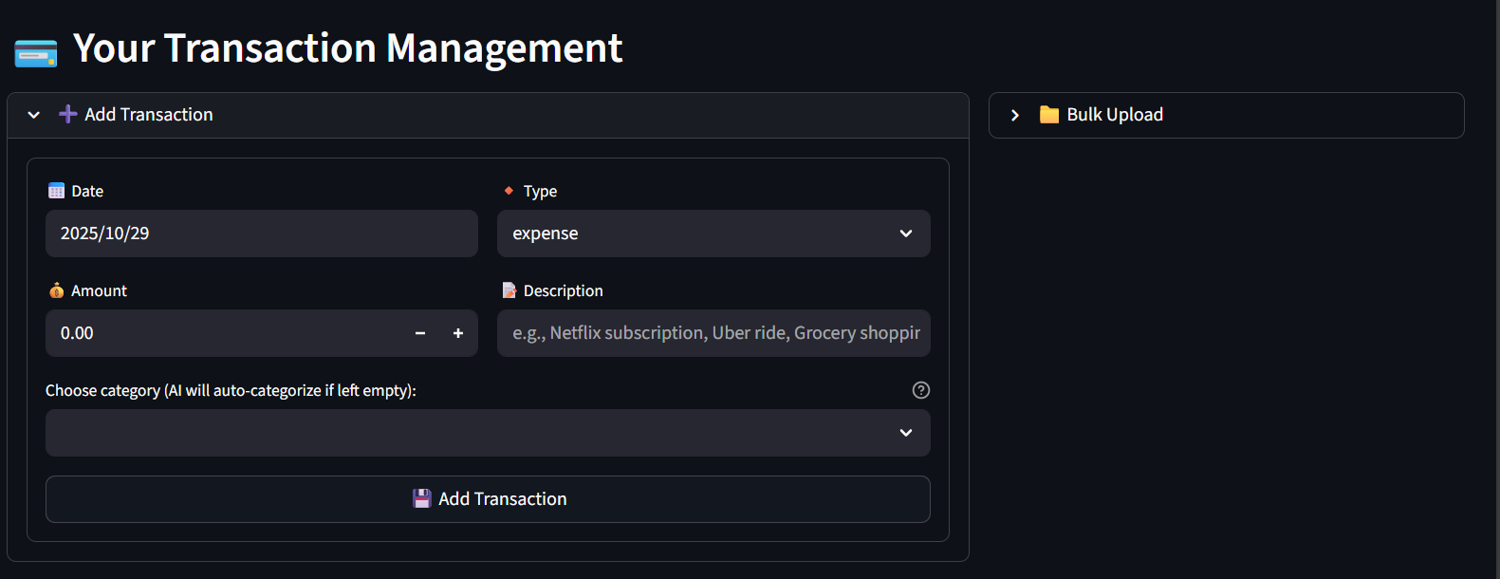
User Interface - Transaction Input

Slide 10
Features Shown:
Expandable transaction form
Date picker and amount fields
Description input with placeholders
Category dropdown with AI hint
Form validation and submission

Slide 11
Database Design - Milestone 1
Tables Created:
sql
USERS Table:
- id, email, password_hash, created_at
TRANSACTIONS Table:
- id, user_id, date, amount, description, category, type
Relationships:
One-to-Many: Users → Transactions
Foreign Key constraints
Automatic timestamps
Data integrity enforcement

Slide 12
Security Implementation
Authentication Security:
🔒 Password Hashing: bcrypt with salt
🎫 JWT Tokens: 7-day expiration
🛡️ Token Validation: Signature verification
🔐 Session Management: Secure token storage
🚫 Error Handling: No information leakage
Data Security:
User data isolation
SQL injection prevention
Input validation
Secure API endpoints

Slide 13
Milestone 1 Achievements
Working user registration system
Secure login/logout functionality
Transaction input with validation
User-specific data isolation
Responsive web interface
Error handling and user feedback
Database schema and relationships

Slide 14
🎯 User Benefits:
Secure account creation
Easy transaction entry
Immediate data persistence
Clean, intuitive interface

Slide 15
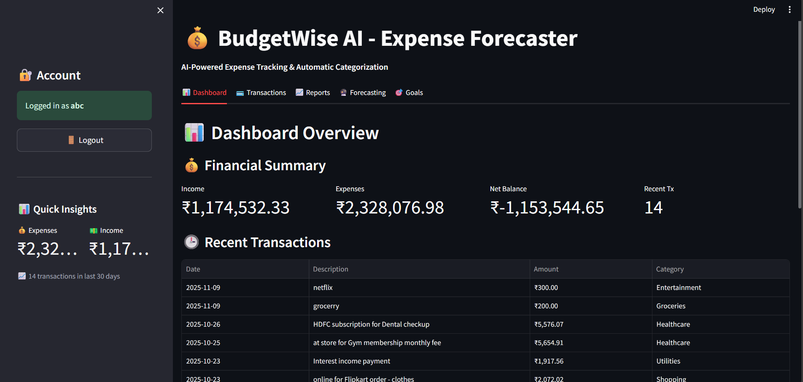
Overall Interface

Slide 16
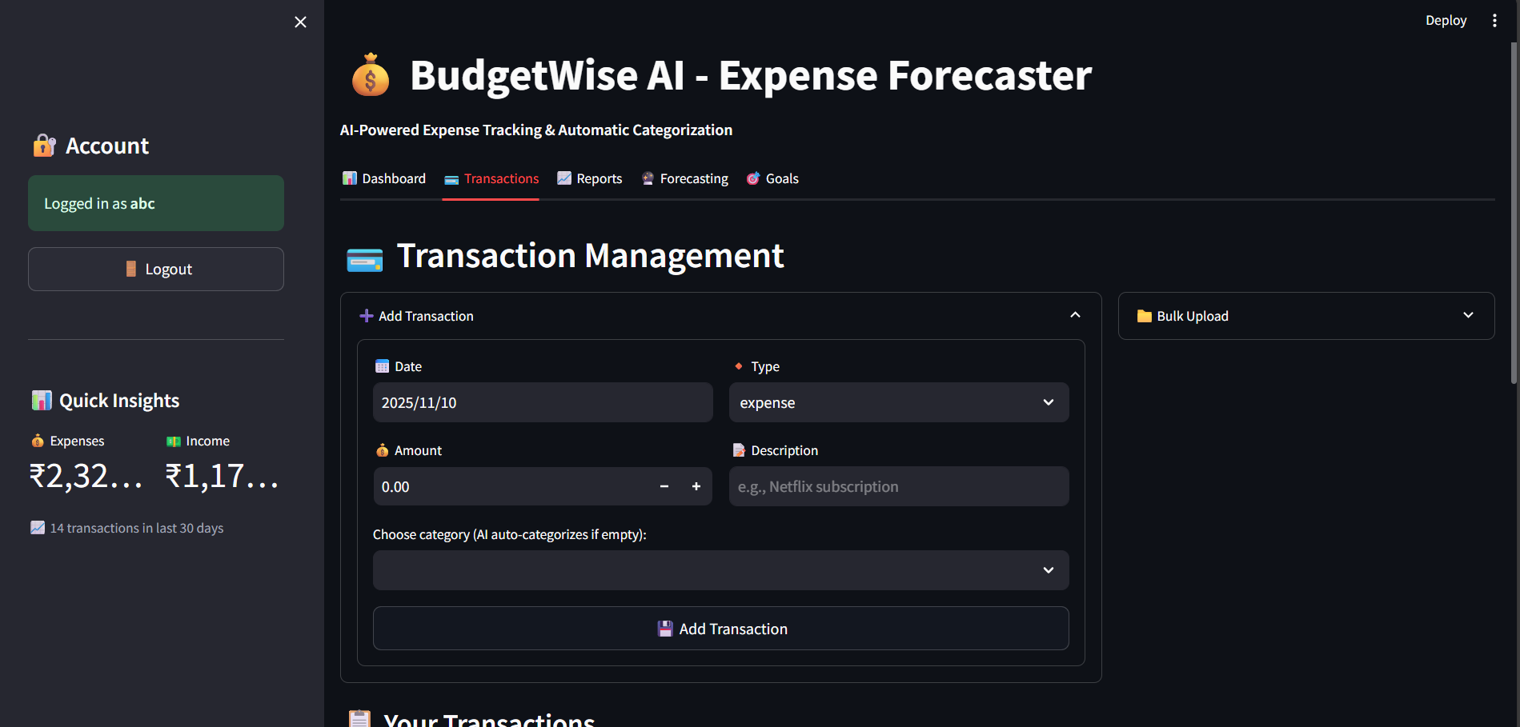
Overall Interface

